Slide 1

Exploring the relationship between marketing spending and revenue
A (very) short summary of the findings

Slide 2
SQL QUERY
Selected relevant tables and variables
Agregated by product category and date
Merged data into a single table

Slide 3
Additional preprocessing
Grouping by quarter to avoid rank defficiency
Omitting variables to avoid mulicollinearity and based on ambiguous definitions.

Slide 4
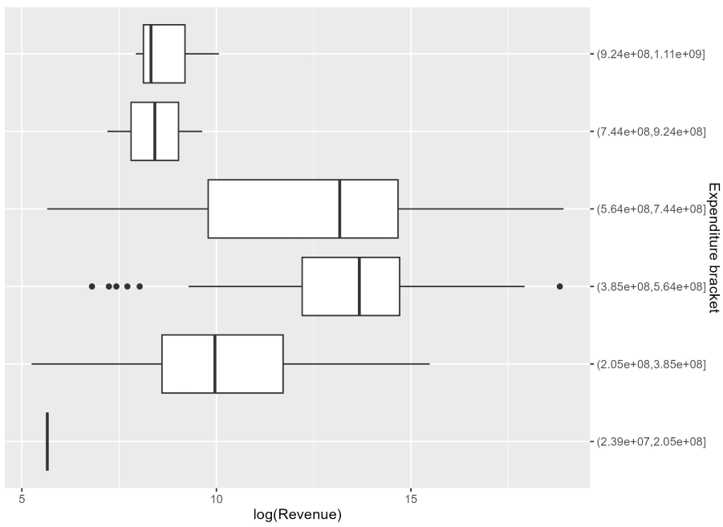
Data exploration
Positive relationship with diminishing returns

Slide 5
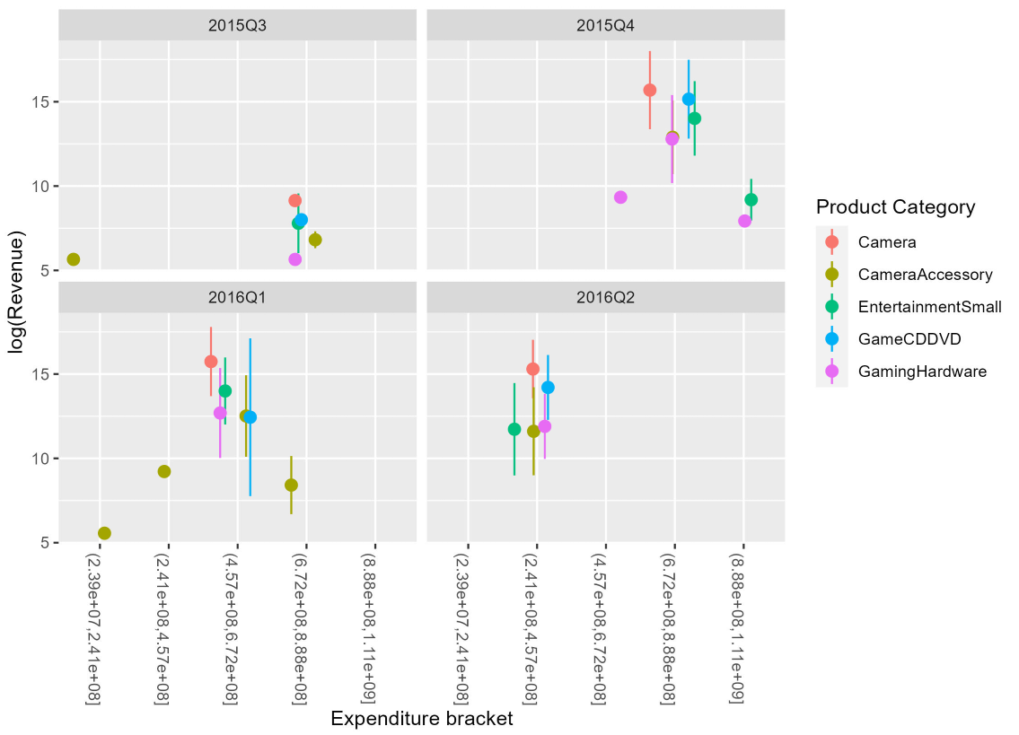
Data exploration
Positive relationship across quarters and product types

Slide 6
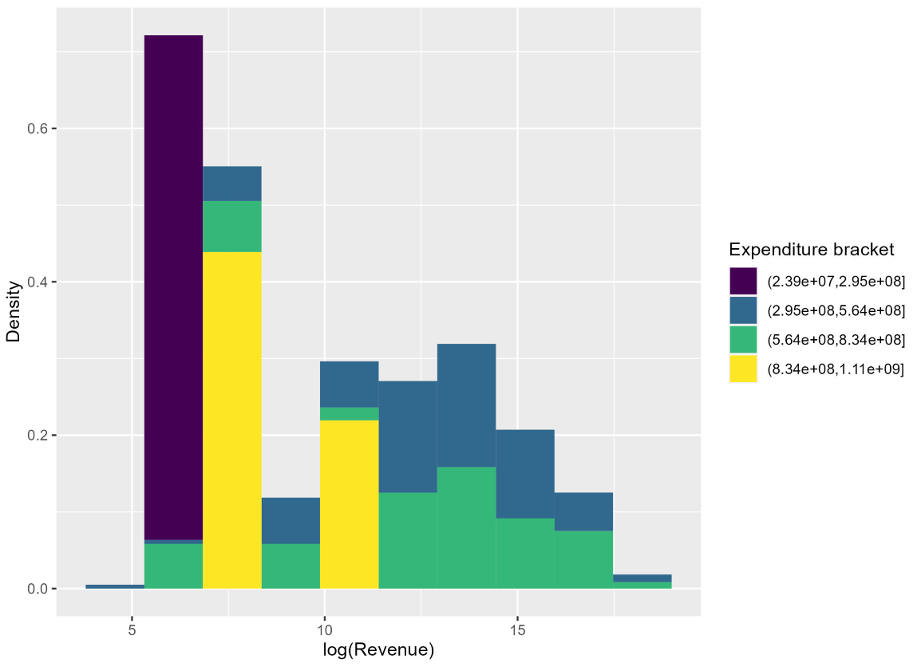
Data exploration
Lowest levels of expenditure densely grouped toward the lower tail of the revenue distribution.

Slide 7
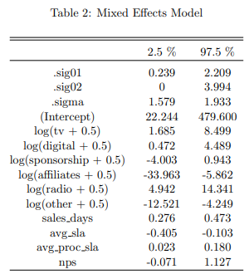
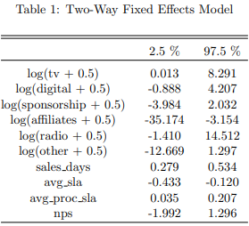
Parametric models (TWFE and ME)
Similar estimations, closer along the upper bounds.
Provide evidence that there is a statistically significant relationship between some categories of expenditure and revenue.
Might still be affected by rank deficiency.

Slide 8
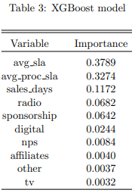
Machine Learning Model (XGBoost)
Modest importance of the expenditure variables in predicting the response variable.
Other variables appear to be more important
Perhaps due to a lack of variability in expenditures along the observation period.

Slide 9
Concluding remarks
Marketing expenditures in this case have no clear evidence of being capable to predict sales. Other variables have more predictive power.
Findings are not robust to different specifications. However, some variables seem to have a consistent impact (e.g. spending on TV).
More data would be useful to avoid dimensionality problems.
SEE MORE DETAILS IN THE COMPLETE REPORT.

